Slide 1
E.C. Brooks Parent Night
An Evening of Information!

Slide 2
Agenda
Brooks Webpage
Pearson Online
BouncePages App
Keyboarding Without Tears
STAR Testing

Slide 3
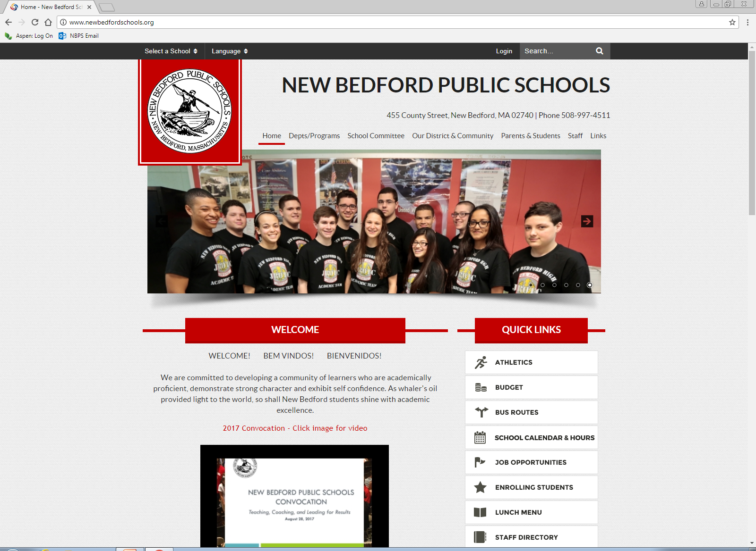
Brooks Webpage
Our goal is for our webpage to be more of a resource for families at home.
To find our webpage:
  Go to New Bedford Public Schools
  Find Brooks under “Select a School”

Slide 4
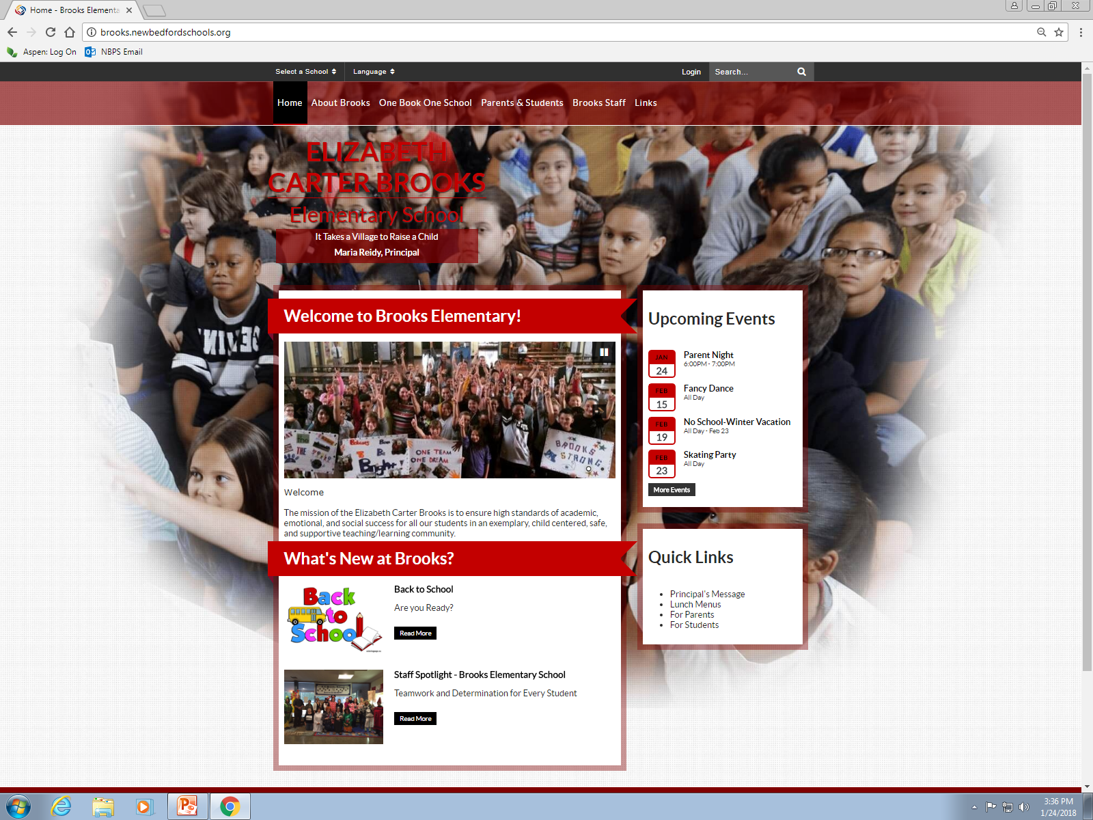
Brooks Webpage
3 & 4
Most Frequent Uses:
  Calendar of Events
  Breakfast and Lunch Menus
  PTA Information
  Student Links
1
2
3
4

Slide 5
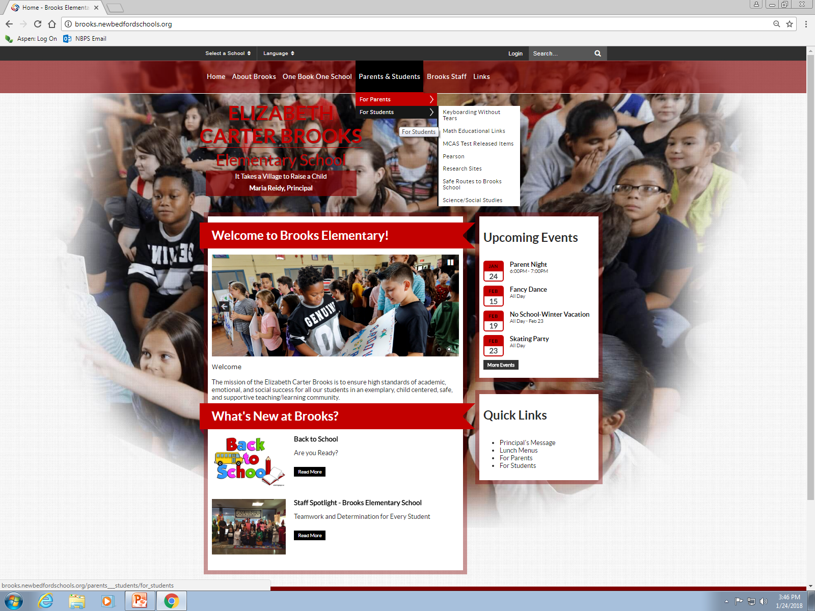
Student Links
Pearson Online
Keyboarding Without Tears (Grades 3 & 4 only)

Slide 6
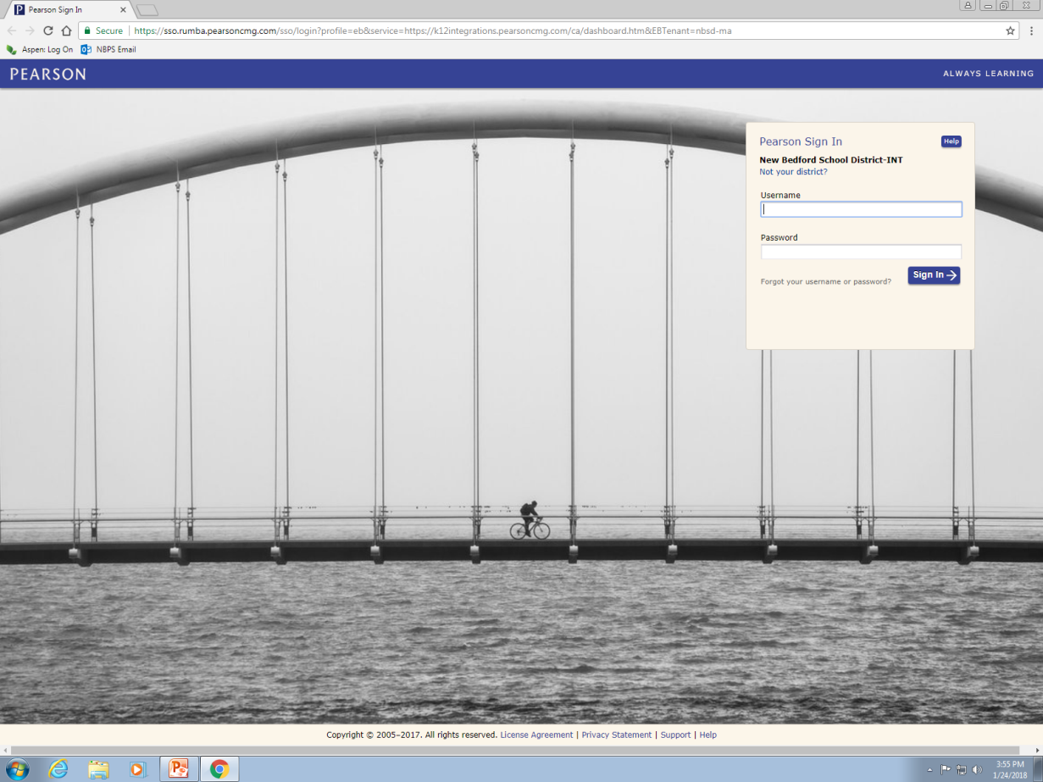
Pearson Online
Students have the ability to access their materials in ELA, Math and Science.
They can complete assignments given by the teacher.
You can access videos to see what concepts are being taught to your child.
You can access materials to better understand what is expected on homework.
Students need their log in credentials.
Student Log In Credentials:
Username: First and Last Initial plus their Student ID#
Password: nbps plus their Student ID# and !
For example, James Darling #12345
Username: jd12345
Password: nbps12345!

Slide 7
BouncePages App
(Math Homework Only)
https://www.youtube.com/watch?v=IiA3yGhYM18
If you have a smartphone, there is an app that you can take a picture of your child’s math homework (Pearson only) and see a video on the concept.
The link shows a Youtube video tutorial on how to use the app.

Slide 8
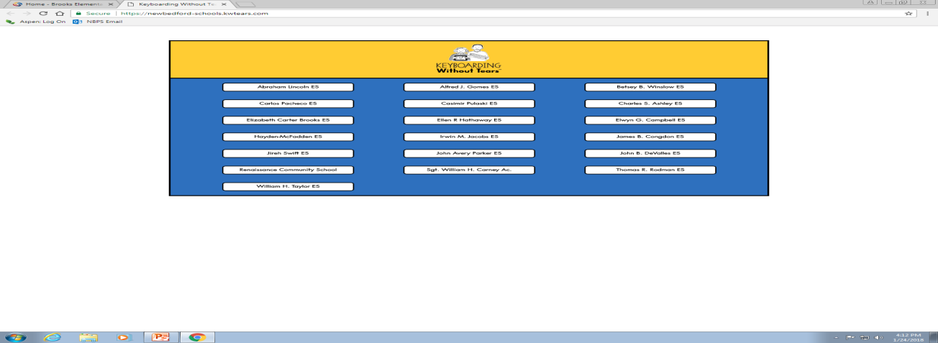
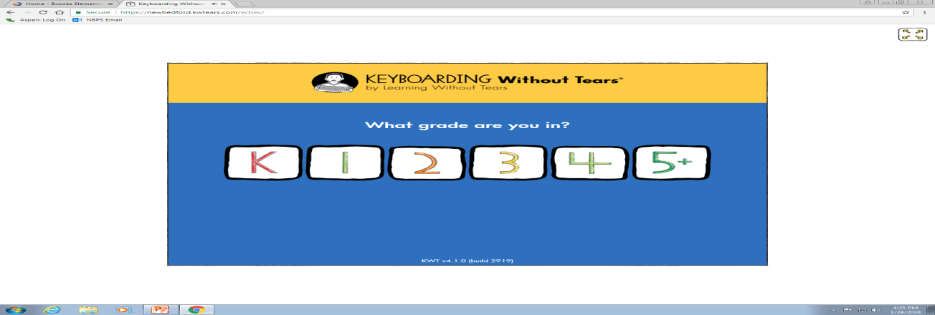
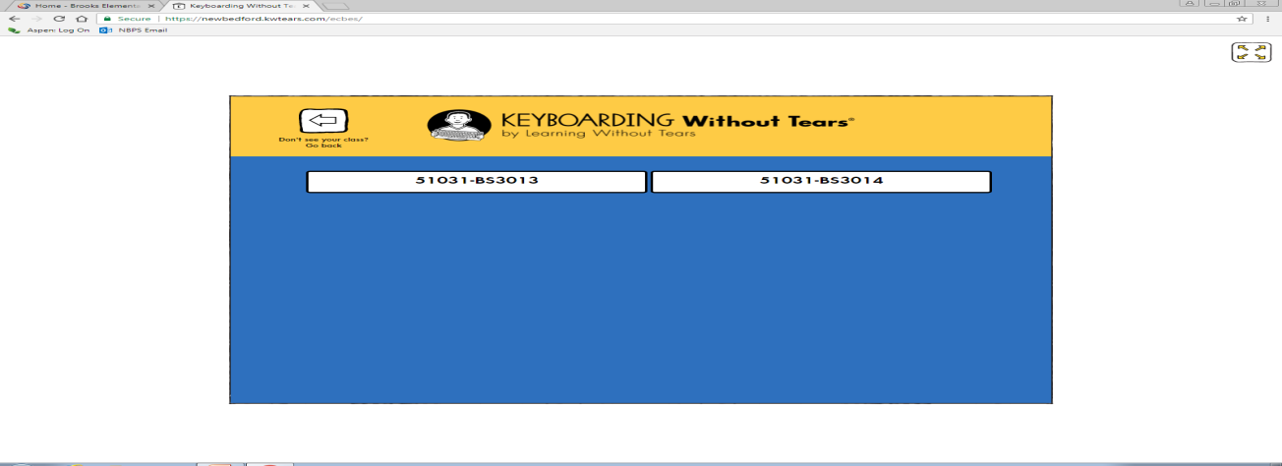
Keyboarding Without Tears
Personalized typing program that encourages proper hand placement. The program does include curriculum standards at the same time as students develop their typing skills.
Students need their log in credentials.
Click “Elizabeth Carter Brooks ES”
Click your grade
Click your class (the last two digits represent the room number)
Click your name
Type in your Secret Code

Slide 9
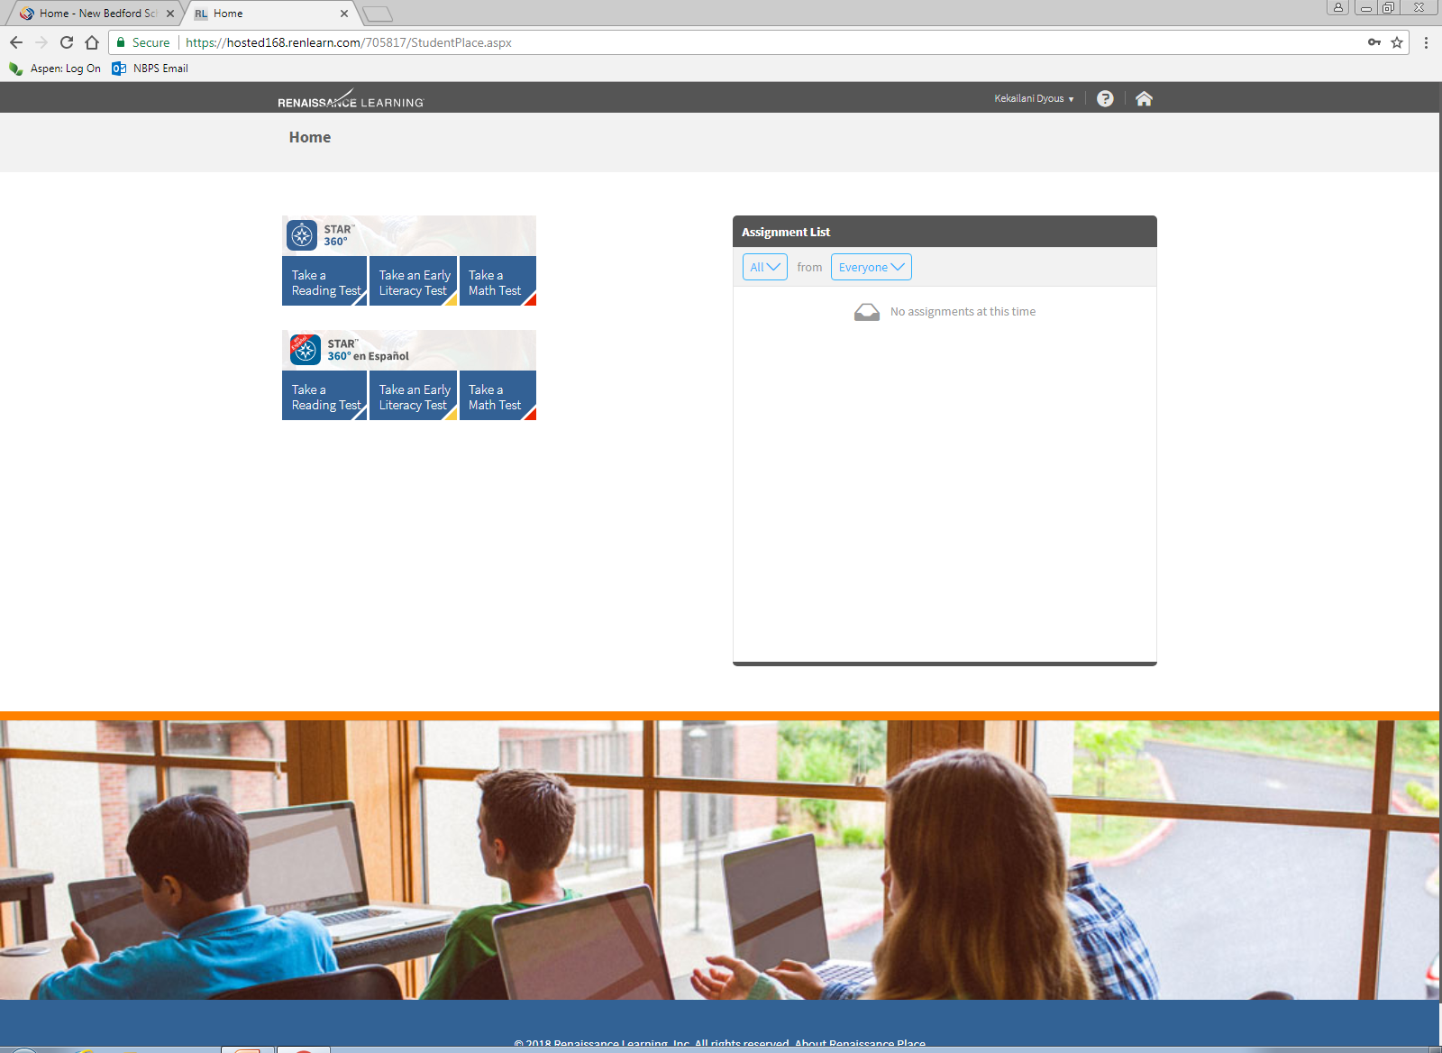
STAR TESTING
Three Tests:
STAR Reading
STAR Math
STAR Early Literacy
  For students whom are developing readers

Slide 10
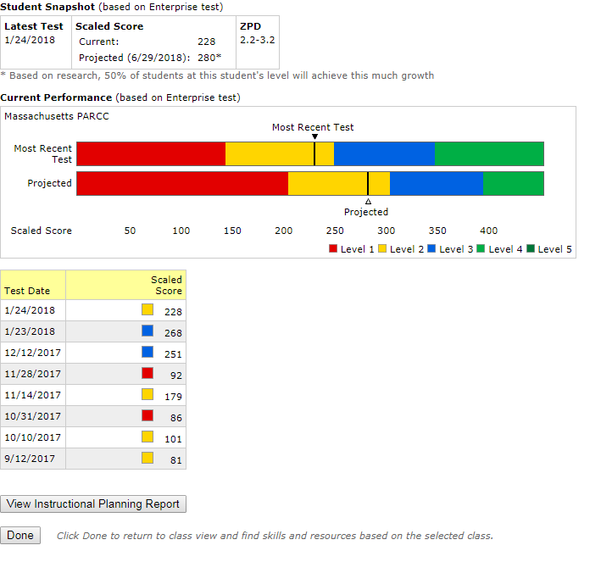
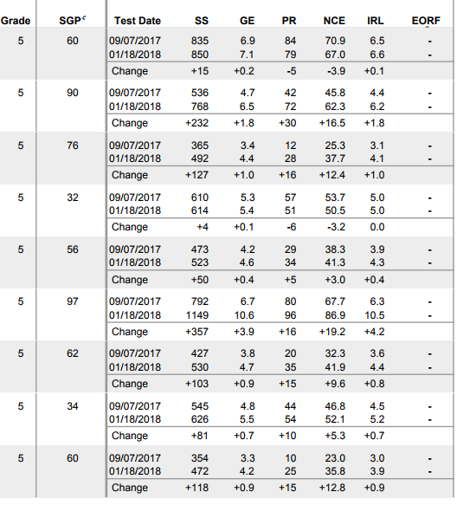
STAR Data
Benefits of STAR Testing:
Students are compared to similar students across the country
Students develop goals and motivation for improvement
Teachers are able to identify students by Growth & Score
Students are challenged with higher grade level questions without limit
Tests are relatively quick (average test is around 20 minutes)
STAR Scores are relatively strong predictors of MCAS/PARCC performance (about 85% accurate)

